Slide 1
UCSD: Data Bootcamp ETL Project
Team Members: Francis Yu, Chris Ng, Chetan Balachanda, Cris Bangaoil

Slide 2
Goal Statement:
Determine California areas with a high amount of Data Science job openings.
Compare salaries in California areas
Which sites have more Data Science job listings
Keyword Analysis of current open Data Science Jobs

Slide 3




Data Sources

Slide 4
Scraped Data
For each of the 4 career sites we will search for Data Science jobs in California:
Job Title
Company
Location
Salary (if available)
Job Description
URL to each job listing

Slide 5
Methodology
Scrape each site for the data fields
Create a dictionary for each Job Listing
Remove Duplicate listings if Job Title and Company are the same
Save dictionaries in a MongoDB collection
Run Data Analysis use various Python libraries, i.e, Pandas, MatPlotLib
Load Analysis into a website via Flask

Slide 6
Challenges
Selecting the sources that can pull all the required fields
Filtering duplicates from each individual site and then removing the duplicate postings across the various sites
Salary information is not always provided in the listings
Unable to pull the Job Description from each listing

Slide 7
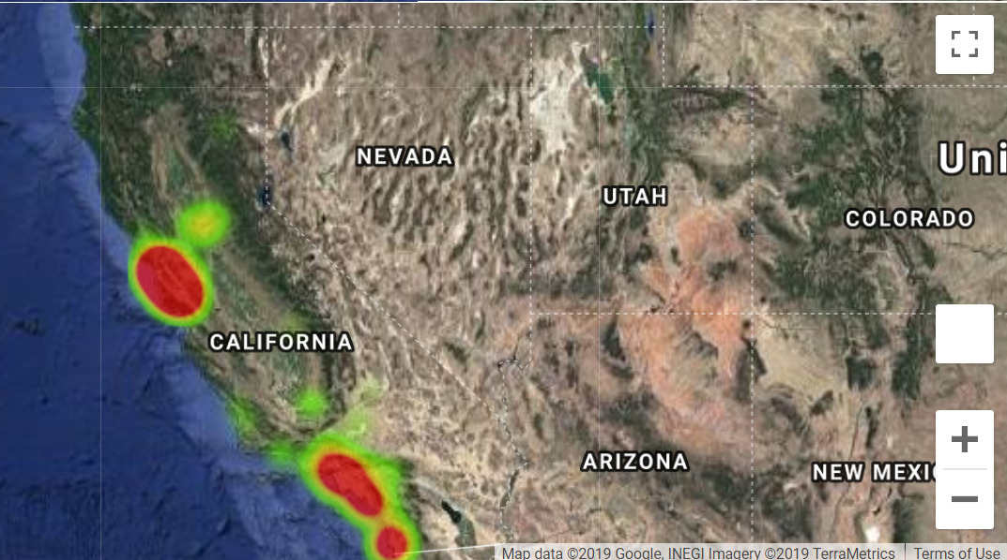
Where should you move to
Heat map of current Data Science openings in California

Slide 8
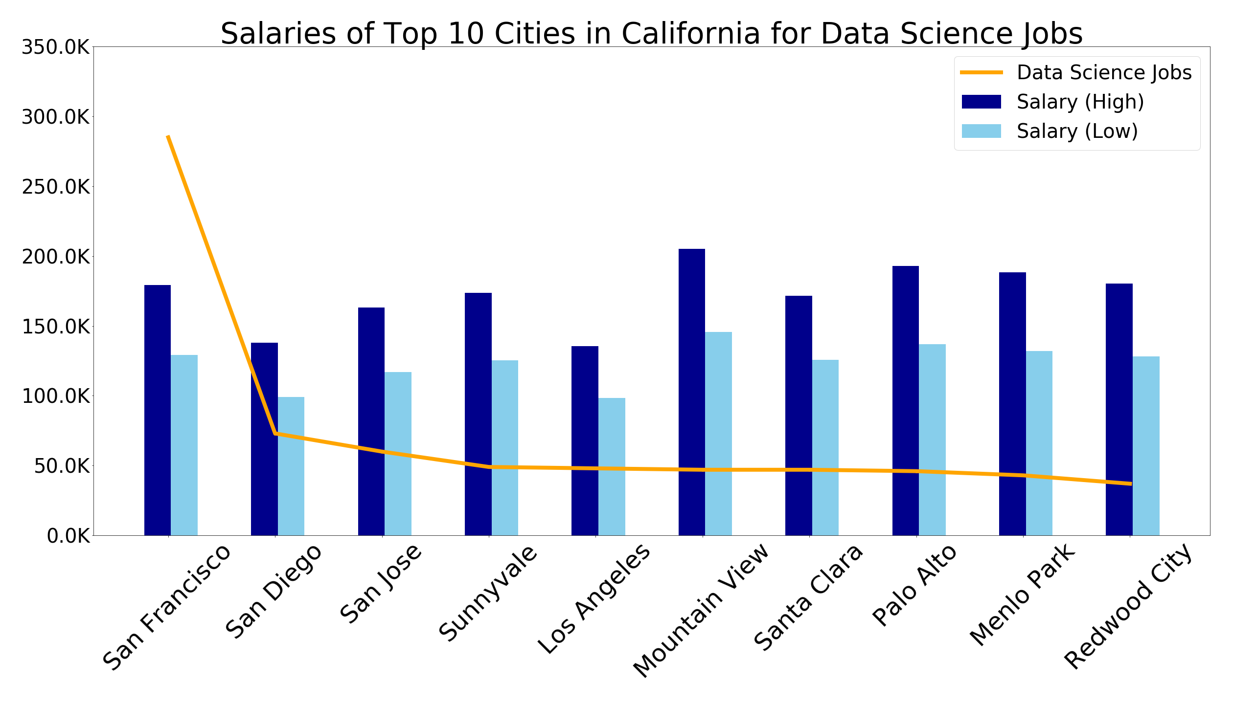
Where should you move for the Money
Combines job frequency data with average salaries per city

Slide 9
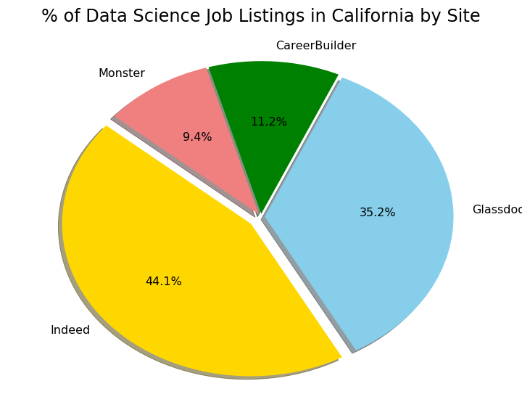
Which site should you visit most
Pie chart of data science jobs of the 4 sources

Slide 10
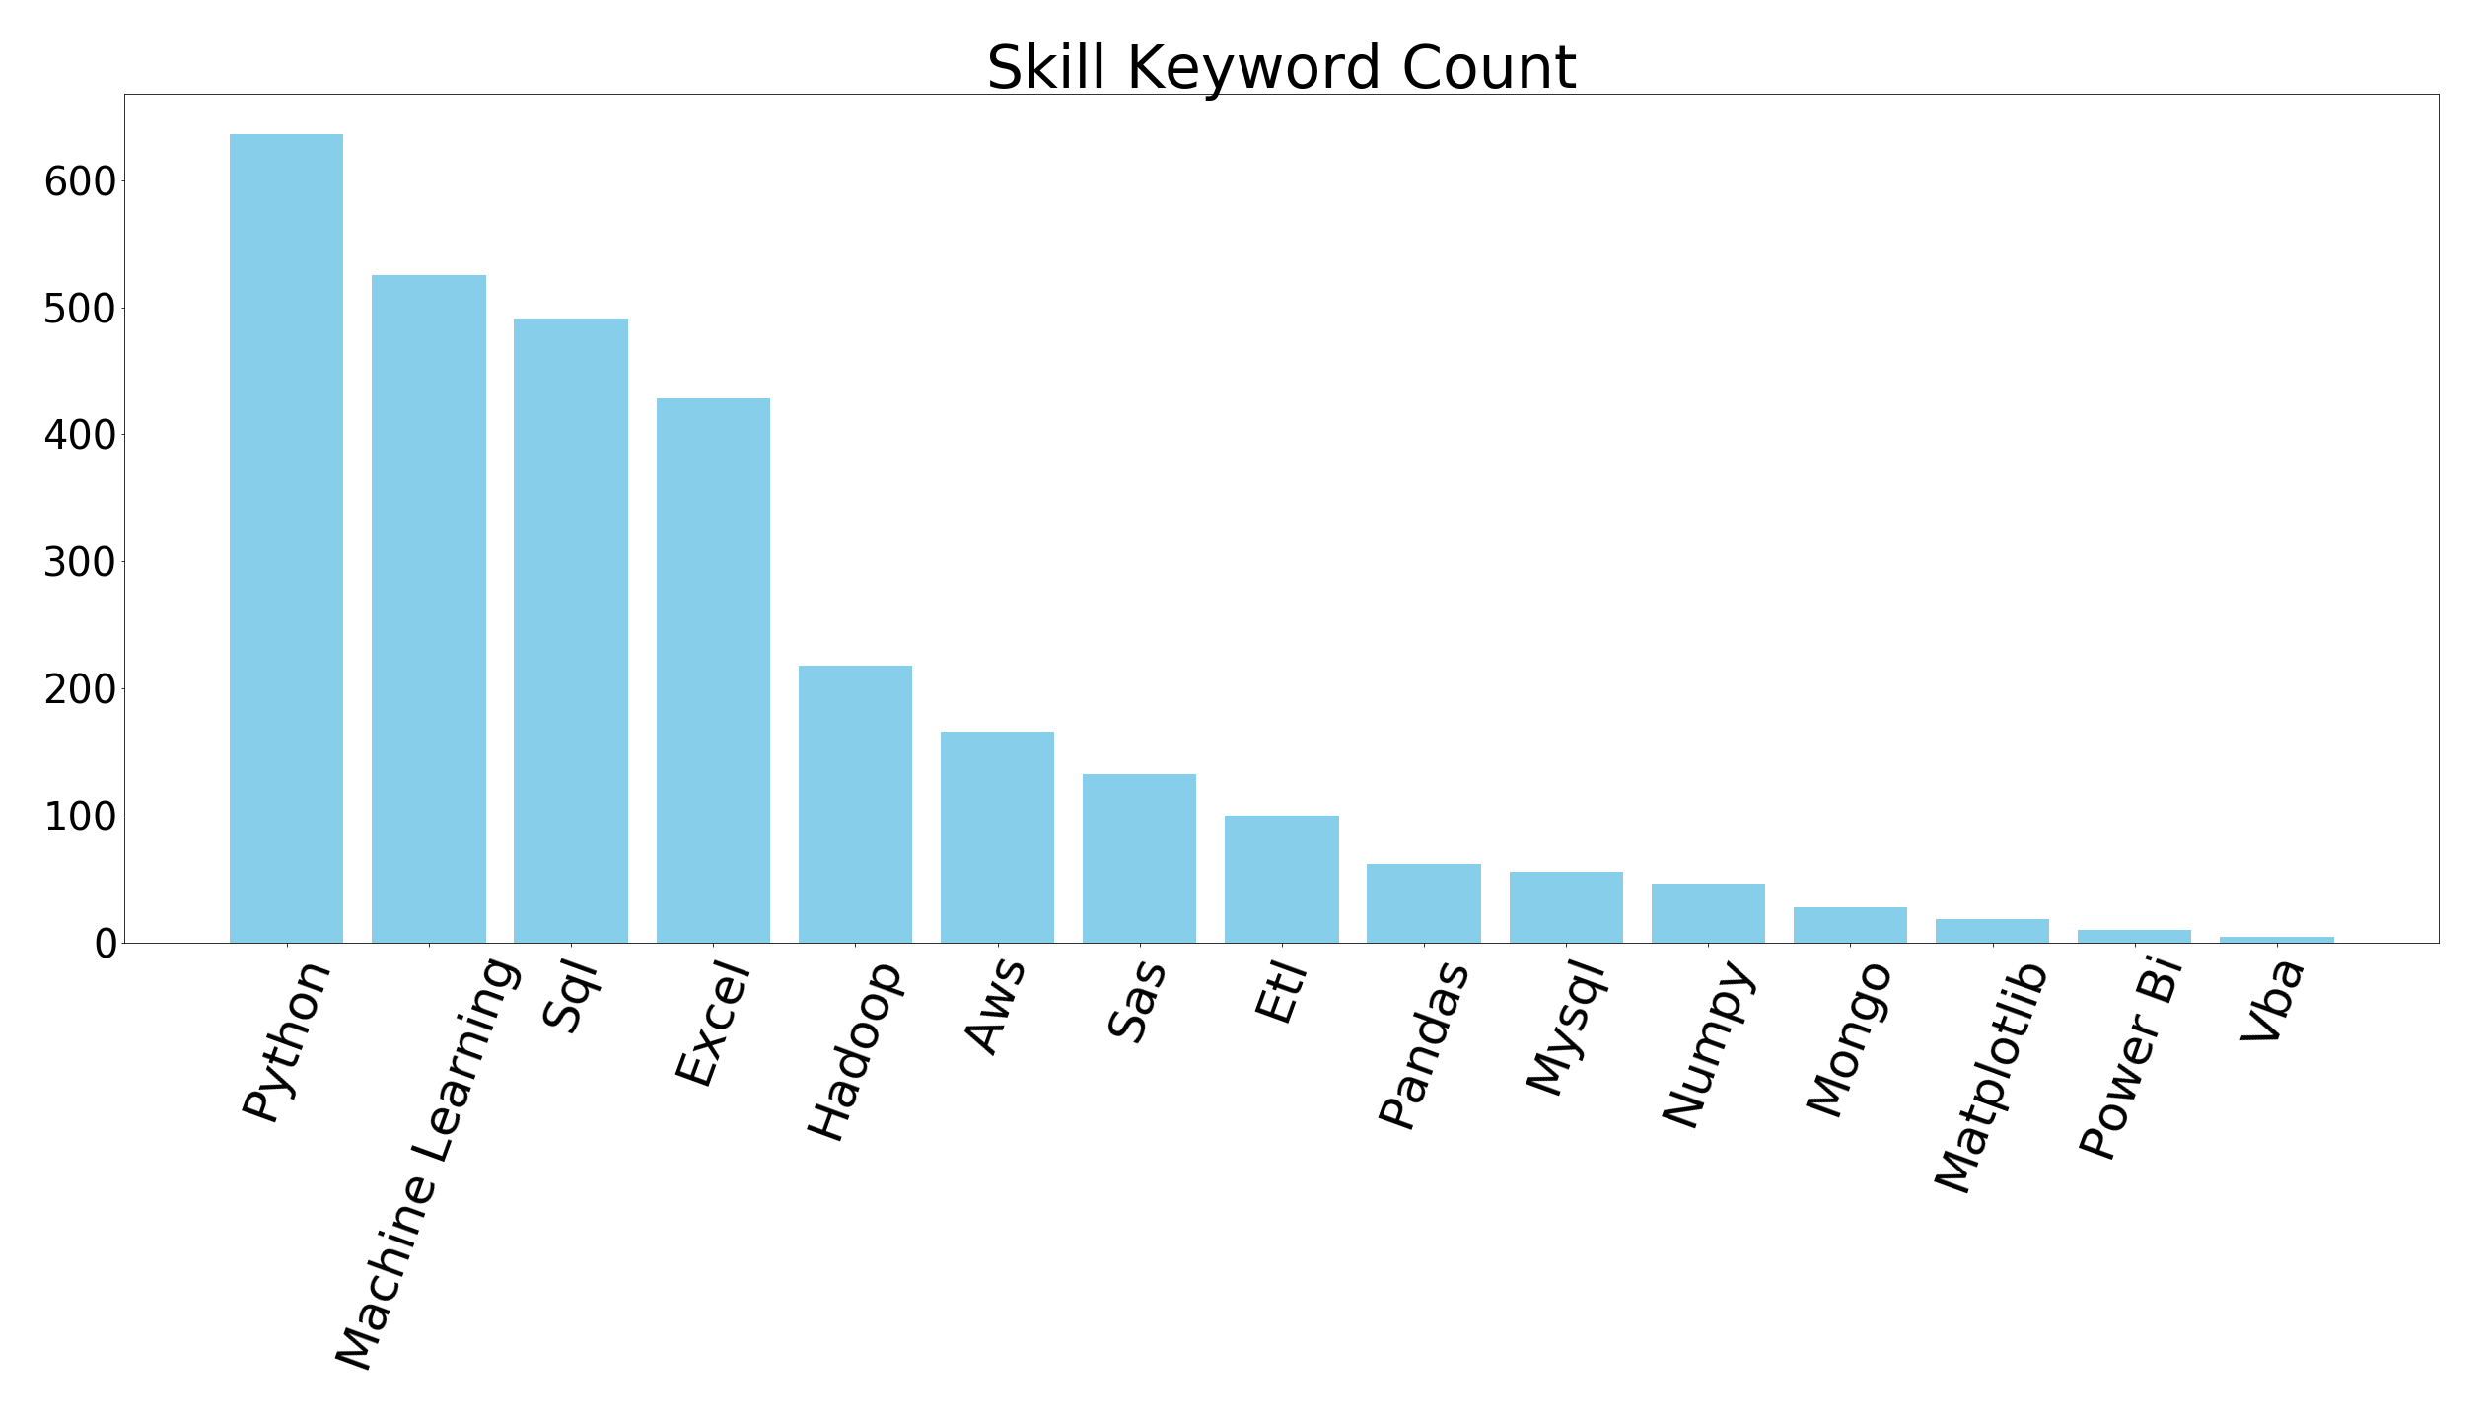
Popular keywords
Popular Keyword frequency in current Data Science job openings

Slide 11
Conclusions
Surprise! Move to the Bay Area
Get paid (and then increase your expenditures)
Set job alerts on Glassdoor and Indeed
Make sure you put the following on your resumes:
Python, Machine Learnings, SQL, Excel, Hadoop

